Slide 1
JAVA Programming
Course Instructor: Dr. Suvojit Dhara
School of Computer Science
UPES Dehradun

Slide 2
Course Logistics
Course Code: CSEG 7031_4
Class Timings: Monday (10:00 AM – 10:55 AM)
Tuesday (1:00 PM – 1:55 PM) Theory
Wednesday (2:00 PM – 2:55PM)
Tuesday (8:00 AM – 9:55 AM) LAB
Room Number: 4003 (Block-IV) + 4002 (Block-IV)

Slide 3
Study Material
Prerequisites: Basic Knowledge of C/C++ Programming, Object Oriented Programming
Lecture Slides
Books:
(1) Head First Java (3rd Edition) – K. Sierra, B. Bates & T. Gee
(2) The Complete Reference Java (7th Edition) – Herbert Schild, TMH
(3) Head First Servlets and JSP (2nd Edition) – B. Basham, K. Sierra, B. Bates

Slide 4
Course Evaluation
Mid Semester Examination (20%)
End Semester Examination (30%)
Internal Assessment (50%)
- Quizzes (7) – 20 marks each (Best 6) [30%]
- Classtests (3) – 15 marks each (Best 2) [30%]
- Assignments (3) – 20 marks each (Best 2) [40%]

Slide 5
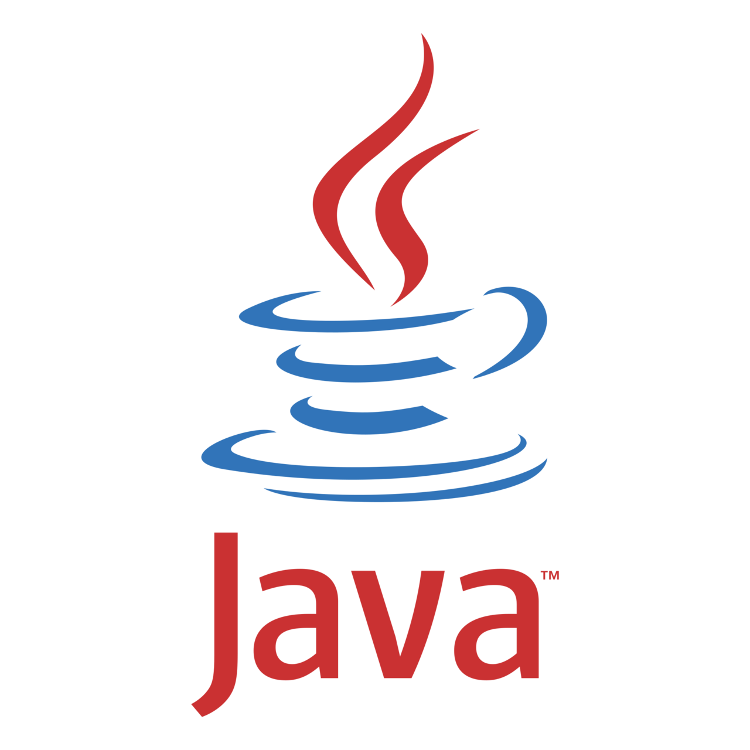
Let’s START THE JOURNEY Together…!!!

Slide 6
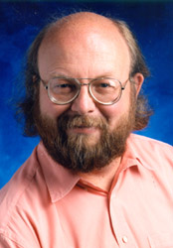
Brief History of JAVA
James Gosling, Mike Sheridan, and Patrick Naughton initiated the Java language project in June 1991. This small team of Sun engineers was called Green Team.
Firstly, the language was called “Greentalk” by James Gosling, and file extension was .gt.
Java was originally designed for small, embedded systems in electronic appliances like set-top boxes, but at that time, it was too advanced technology for the digital cable television industry.
After that, it was called Oak, and was developed as a part of the Green project. Java team-members initiated this project to develop a language for digital devices.
Later, Java technology was incorporated by Netscape as it was suited for networking.
James Gosling

Slide 7

Why the name JAVA???
Java was called Oak as it is a symbol of strength and chosen as a national tree of many countries like U.S.A., France, Germany, Romania, etc.
The team wanted something that reflected the essence of the technology: revolutionary, dynamic, lively, cool, unique, and easy to spell and fun to say.
In 1995, Oak was renamed as Java (An island of Indonesia is named Java where first coffee was produced, called java coffee)
In 1995, Time Magazine called Java one of ten best products of 1995.
JDK (Java Development Kit) 1.0 released in January23, 1996.

Slide 8
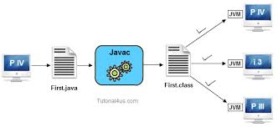
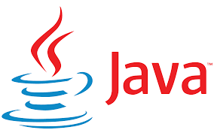
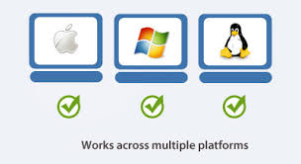


Characteristics of JAVA
Robust
Simple
Architecture-Neutral
Object
Oriented
Platform Independent / Portable
Distributed
Dynamic
Secure
High
Performance
Multi-threaded

Slide 9
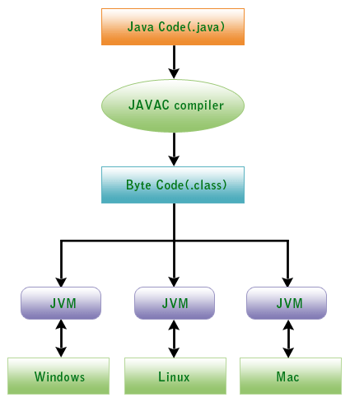
JAVA is Architecture-Neutral
Write (W)
Once (O)
Run (R)
Anywhere (A)

Slide 10
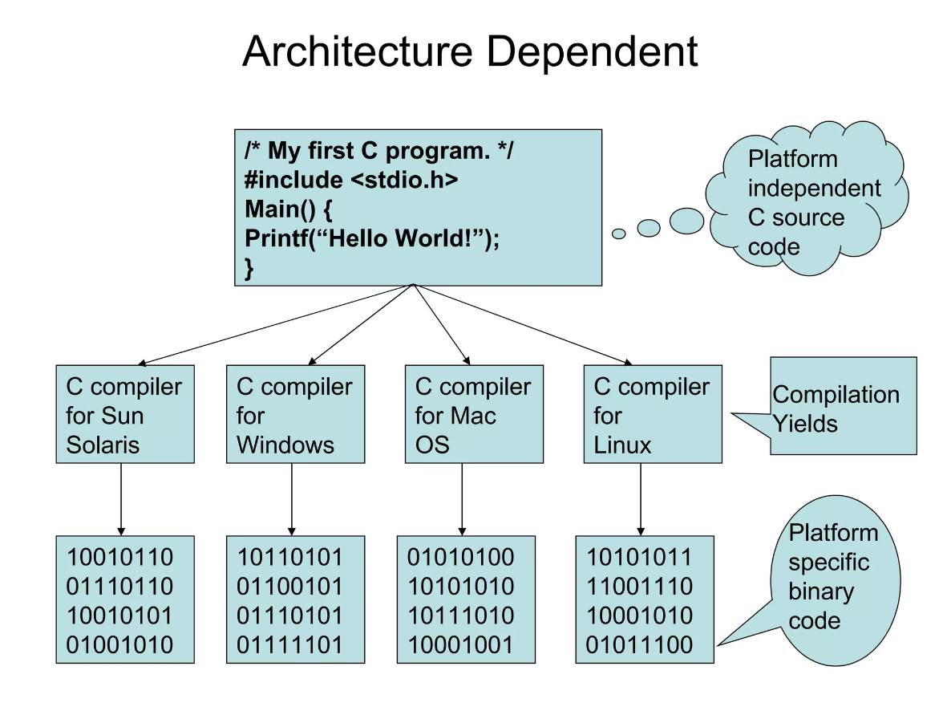
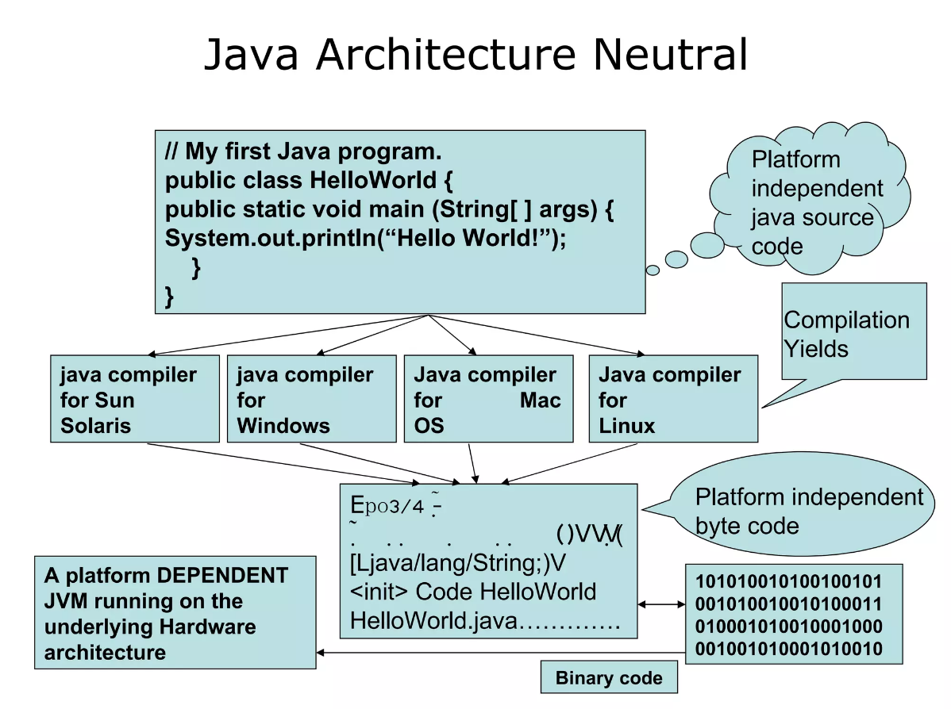
JAVA is Architecture-Neutral (Contd..)

Slide 11
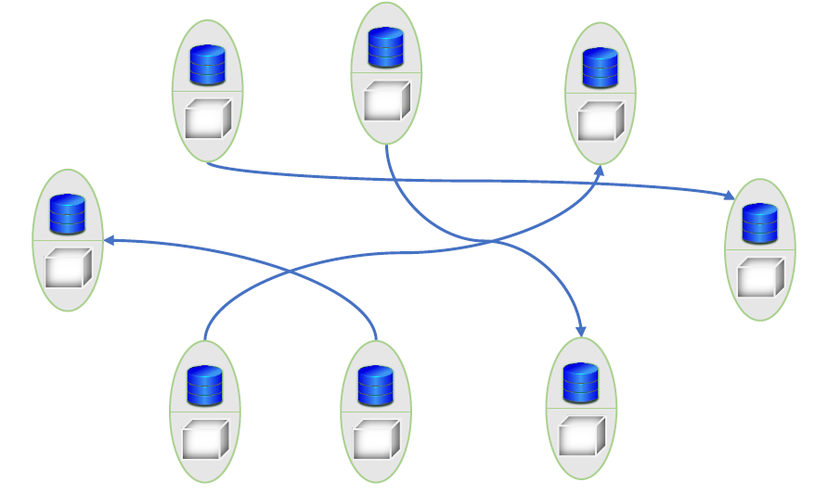
Object Oriented Paradigm of JAVA
Java is based on the concept of Object-Oriented Programming (OOP).
As the name suggests, at the centre of it is (are) an object(s).
Objects contain both data and the functionality that operates on that data.
Encapsulation
Inheritance
Information hiding
Polymorphism

Slide 12
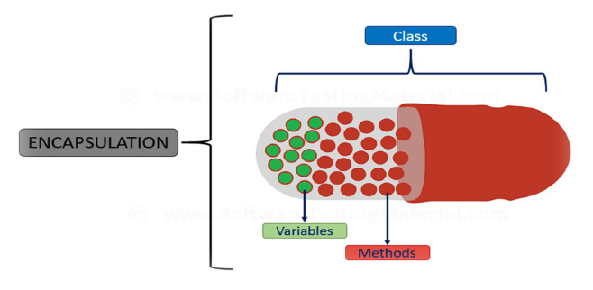
Encapsulation
Encapsulation in Java is a process of wrapping code and data together into a single unit.
For example, a capsule which is a mix of several medicines.

Slide 13
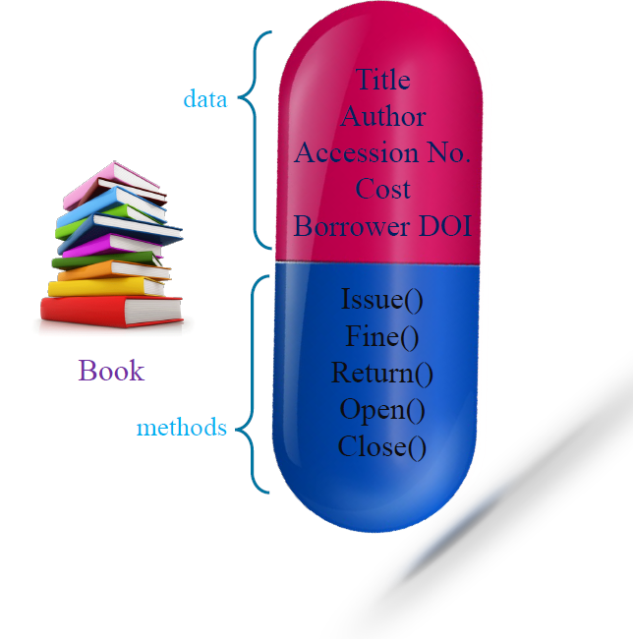
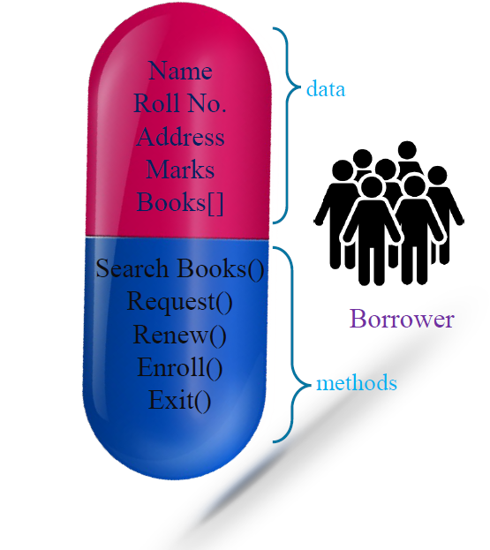
Encapsulation (Example)

Slide 14
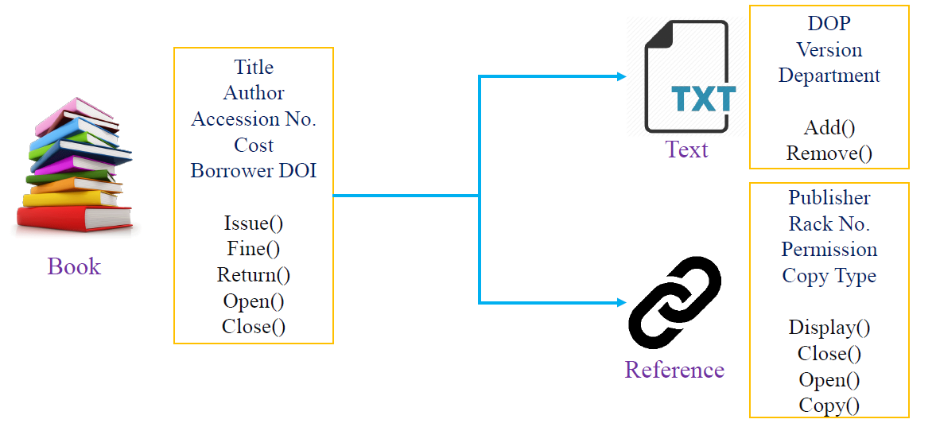
Inheritance
Inheritance in Java is a mechanism in which one object acquires all the properties (data) and behaviours (methods) of a parent object.
The Child object may have its own data and methods as well.

Slide 15
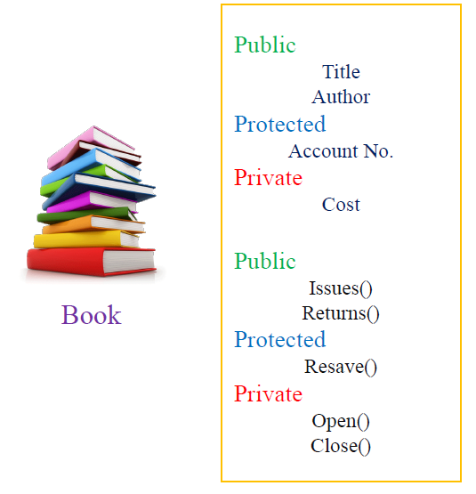
Information hiding
In Java, we have access specifiers which allow the one class of objects to hide relevant information from its child objects and objects of other classes.
Public
Protected
Private

Slide 16
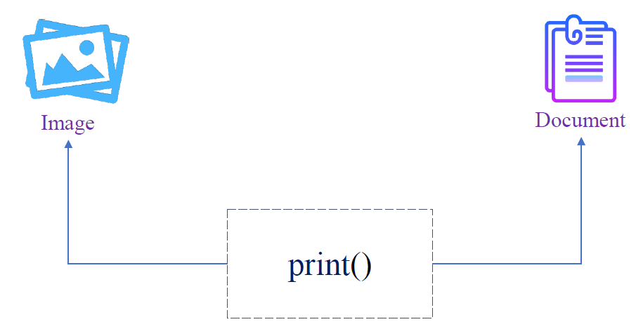
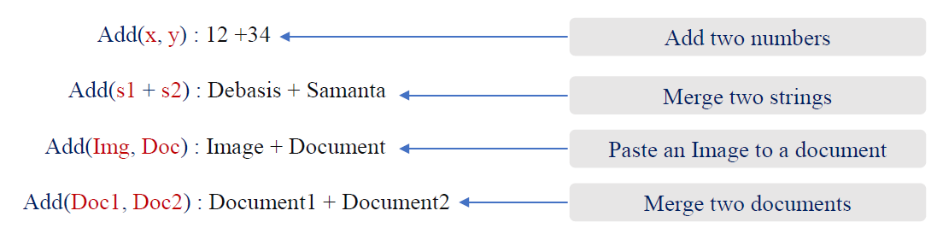
Polymorphism
In Object Oriented Programming (OOP),
Polymorphism refers to a programming language’s ability to process objects depending on their class.

Slide 17
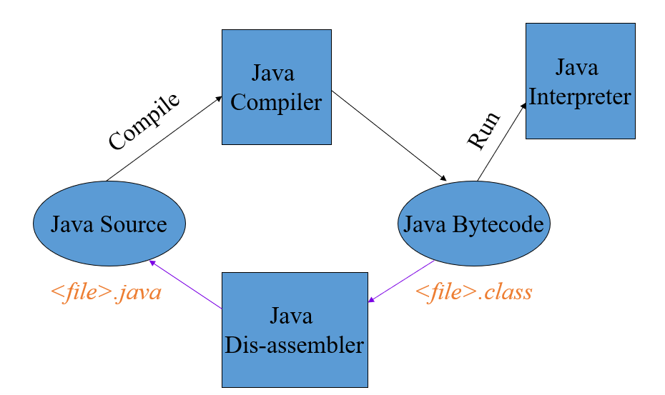
JAVA Program Back-end Setup
Java Developer’s Kit (JDK) – I
Java’s programming environment
Core Java API
compiler
interpreter
debugger
dis-assembler
profiler
more...

Slide 18
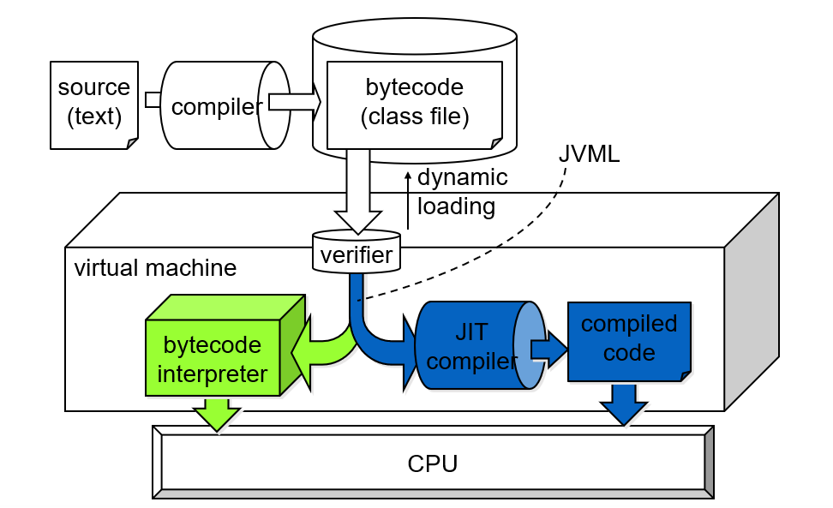
Execution of JAVA Program

Slide 19
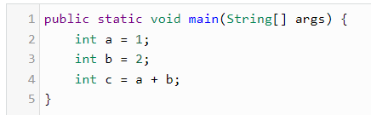
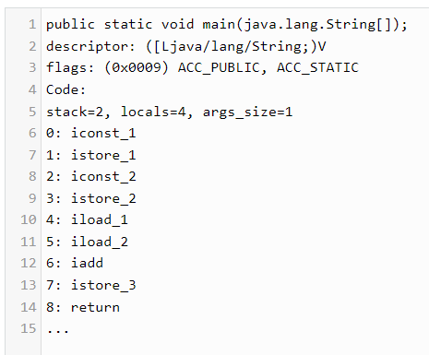
Bytecode
For most languages, compilation produces machine code
Java compilation produces “bytecode”
Intermediate code readable by the VM
Transferable across the Internet as applets
JVM interprets bytecodes into instructions
Partly responsible for performance lag
Bytecode produced on any platform may be executed on any other platform which supports a VM

Slide 20
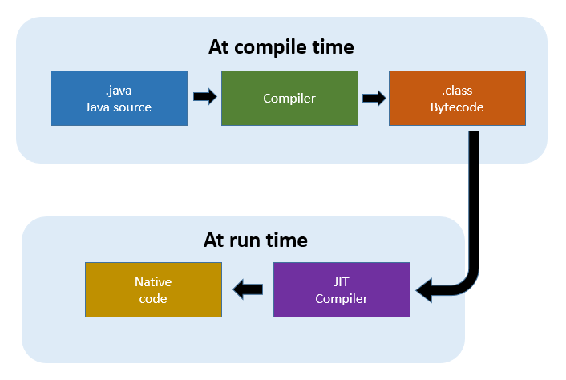
JIT Compiler
Just-In-Time compiler
Translates bytecode into machine code at runtime
1-time overhead when run initiated
Performance increase 10-30 times
Now the default for most JVM’s
Can be turned off if desired
JIT can apply statistical optimizations based on runtime usage profile

Slide 21
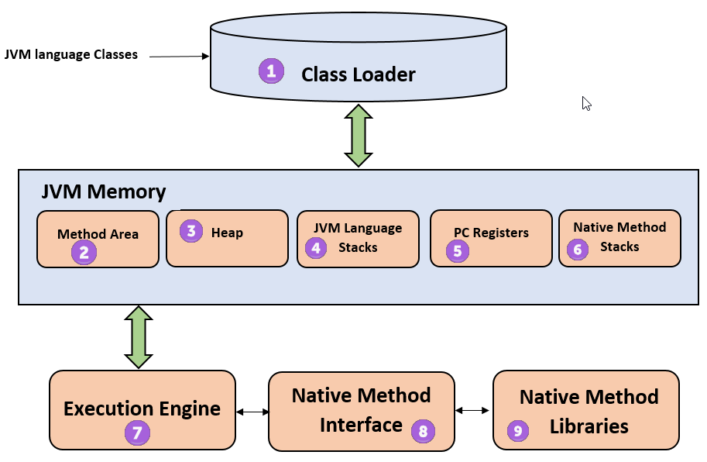
Java Virtual Machine (JVM)
Not just one JVM, but a whole family
JVM (J2EE & J2SE)
Well-known Java Virtual Machine.
CVM, KVM (J2ME)
Small devices.
Reduces some VM features to fit resource-constrained devices.
JCVM (Java Card)
Smart cards.
It has least VM features, etc.

Slide 22
Summary
In this lecture, we learned about
Brief History of JAVA Programming
Features of JAVA Programming Language
Why JAVA is Architecture-Neutral / Portable / Platform-independent?
OOP Concepts in JAVA
Encapsulation
Inheritance
Information hiding
Polymorphism
Back-end Setup and Execution model for JAVA program
Bytecode
JIT Compiler
JVM

Slide 23


